Slide 1

DEEP LEARNING BASED License plate RECOGNITION system
BDP-Team8:
Amar
Karthik
Gayathri
Bindu

Slide 2
INTRODUCTION
In most regions of the world, traffic rule violations have been identified as a major cause of road accidents, with the majority occurring in developing countries.
As a result, a system must be developed to aid law enforcement agencies in enforcing strict rules in order to improve road safety and prevent accidents.
This project employs a Vehicle Plate Number Recognition (VPNR) system, which is a real-time embedded system that recognizes license plate numbers automatically.

Slide 3
MAIN OBJECTIVE
The main aim of the system is to use image processing to identify vehicles violating traffic by their plate numbers.
The acquired image is processed to retrieve the image's numbers. The numbers on the captured image were viewed via an IP address on a web page.
If deployed, the system can be utilized to improve road safety and traffic control in upcoming smart cities. It will also be used to impose appropriate penalties for those who break traffic laws.

Slide 4
TASK DESCRIPTION
As part of this project, we intend to create an application with a trained deep learning CNN model using the RTO API.
We create a model that can recognize characters on the car's license plate from an image.
We then extract the characters and numbers from it, after which we use RTO APIs to get the owner's information.
Finally, we develop a Flask Web application to display all this information.

Slide 5
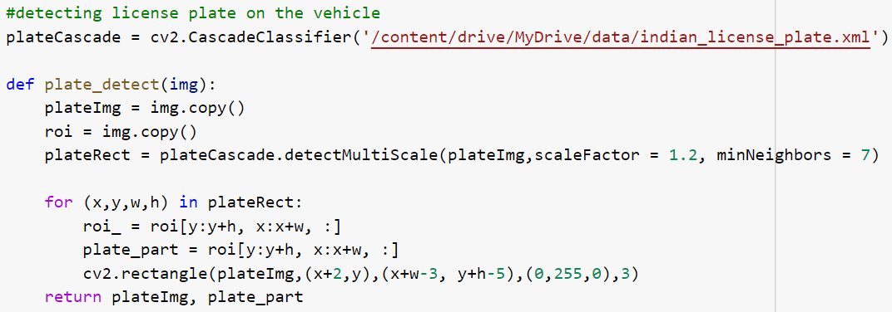
Cascade Classifier
For detecting the vehicle's number plate region, CascadeClassifier is employed. To detect a specific feature or region inside an image, cascading classifiers are utilized. The feature here is a vehicle's number plate.

Slide 6
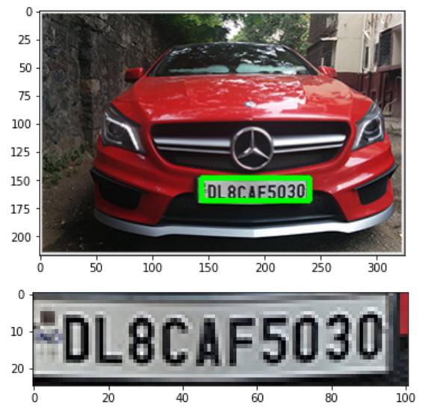
Displaying the Image
We'll read an image named vehicle.jpg, call the plate detect() function, and then display img() takes an image as a parameter and converts it to RGB color coding show the car image and the cropped plate image.

Slide 7
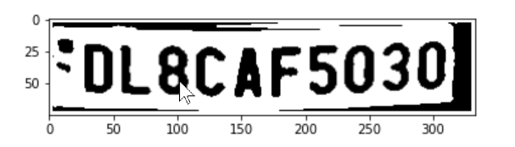
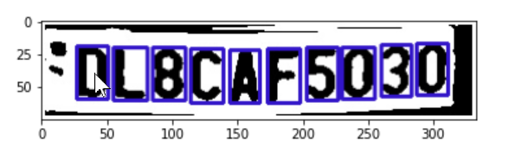
Preprocessing Image
Creates a rectangle around the contours in the number plate image, which are the outline or shape of the outer surface of the numbers with their position.

Slide 8
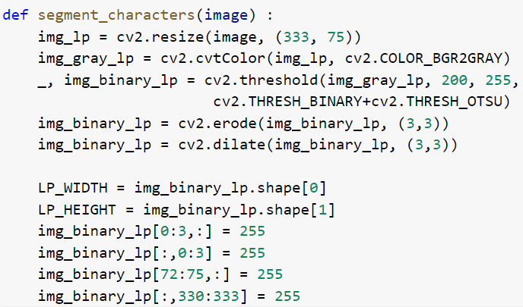

Image Segmentation
The technique of segmenting a digital image into many pieces is known as image segmentation.
The purpose of segmentation is to make an image's representation more meaningful and easier to examine by simplifying and/or altering it.

Slide 9
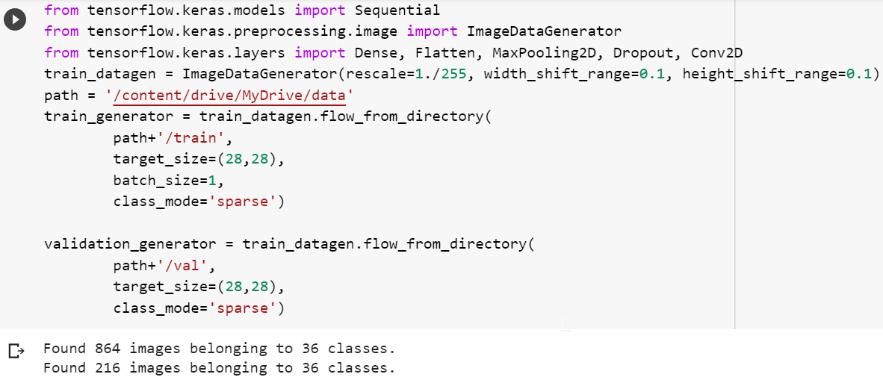
Image Augmentation
Using Keras ImageDataGenerator, create augmented image data from a dataset.
It allows you to make real-time enhancements to your images while your model is still training!
As each training image is delivered to the model, you can apply whatever random alterations you like.

Slide 10
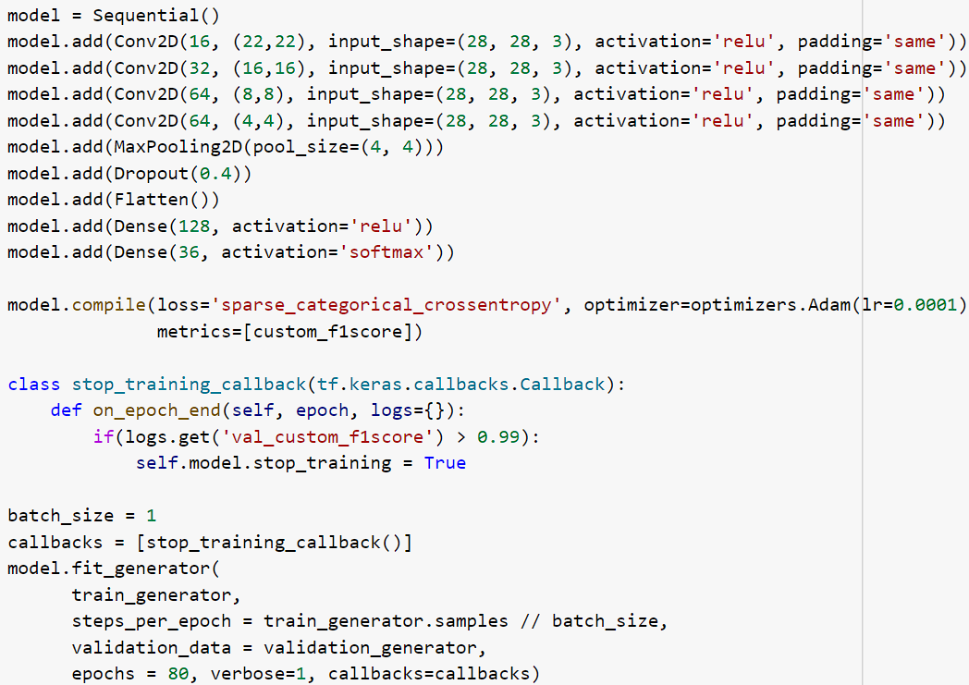
Creating and Training the Model
Adding Deep Learning Layers
Stop_training _callbacks Class
Fitting of Model

Slide 11
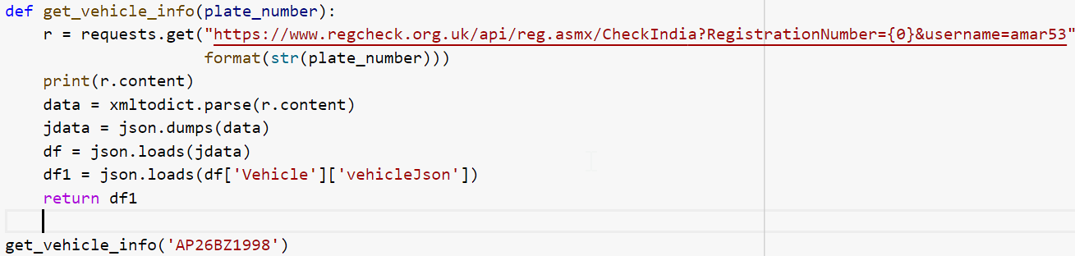
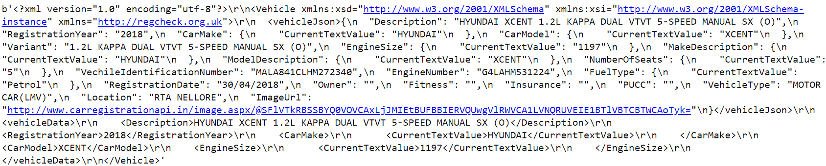
Getting Vehicle’s Owner Information
The final step is to test the model by retrieving vehicle information using the API.

Slide 12
USE CASES
Finding stolen automobiles: This type of project can be set up along the roadside and compares passing cars to a list of stolen vehicles in real time. When a match is identified, an alert is sent to the police officer, informing them of the car that was spotted and the cause for stopping it.
Parking: In vehicle parking, the detected license plate number is utilized to determine parking rates by comparing entry and exit times.
Toll: The car number is used to compute toll road travel fees or to re-check tickets.

Slide 13

REFERENCES
https://medium.com/programming-fever/license-plate-recognition-using-opencv-python-7611f85cdd6c
https://www.researchgate.net/publication/332324949_Robust_License_Plate_Recognition_using_Neural_Networks_Trained_on_Synthetic_Images
https://arxiv.org/ftp/arxiv/papers/1912/1912.02441.pdf

Slide 14
THANK YOU

